Slide 1
Oedipus & Macbeth

Slide 2
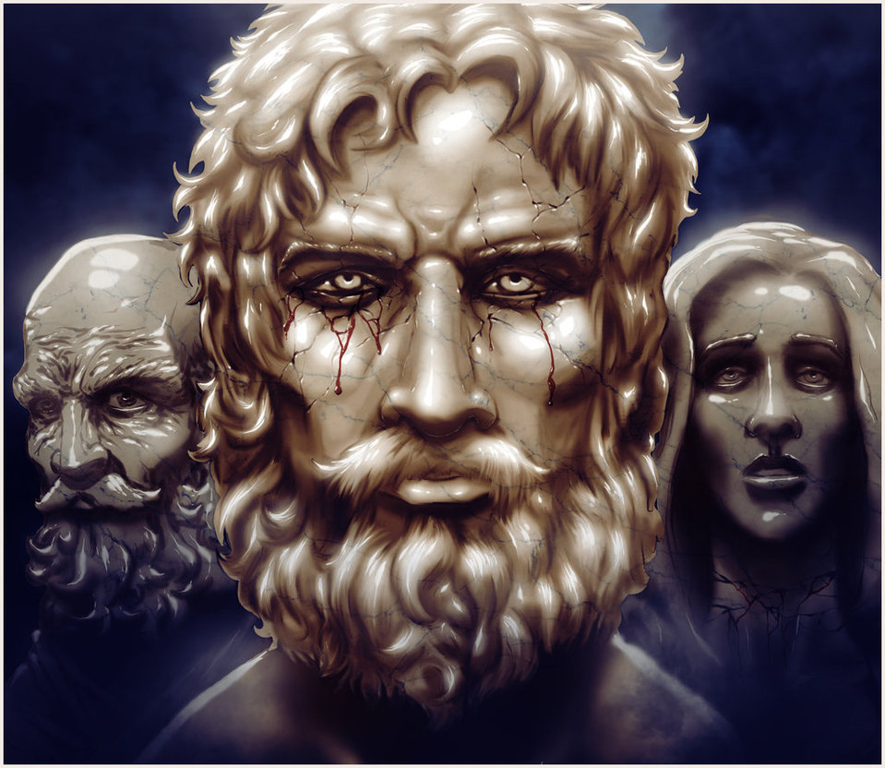
Oedipus Rex
Oedipus was a Greek story about a king who left his kingdom
He returned years later and married a woman, who it later turned out was his mother, and killed a man, who it later turned out was his father
In a rage, he blinded himself with pins

Slide 3
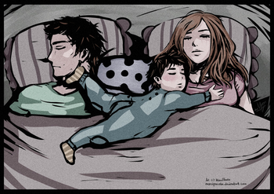
Oedipus Complex
Sigmund Freud, a psychoanalyst, argued that all men secretly desire to marry their mothers and kill their fathers.
He argued that this is a subconscious desire which we repress.
The opposite of it, is called the Electra Complex where girls compete with their mothers for their father’s attention.

Slide 4
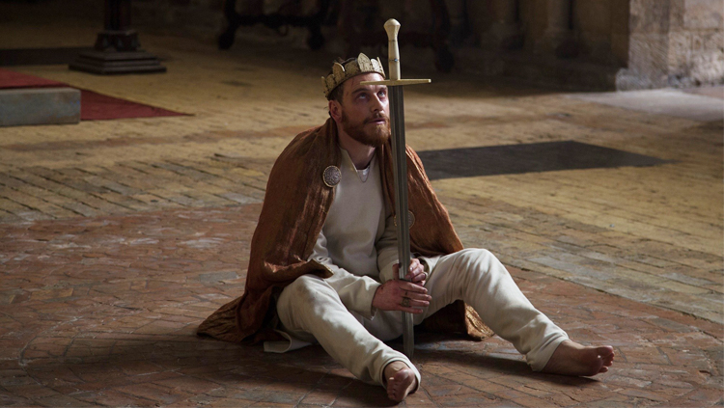
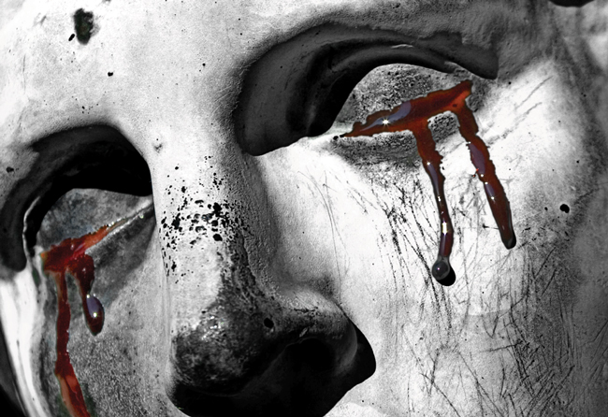
Macbeth & Oedipus

Slide 5
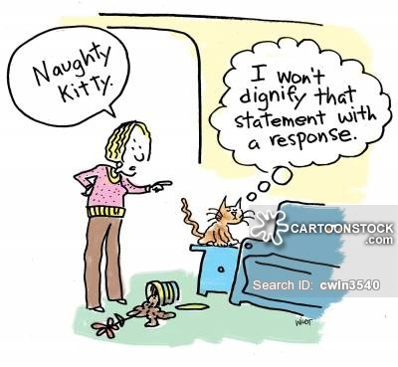
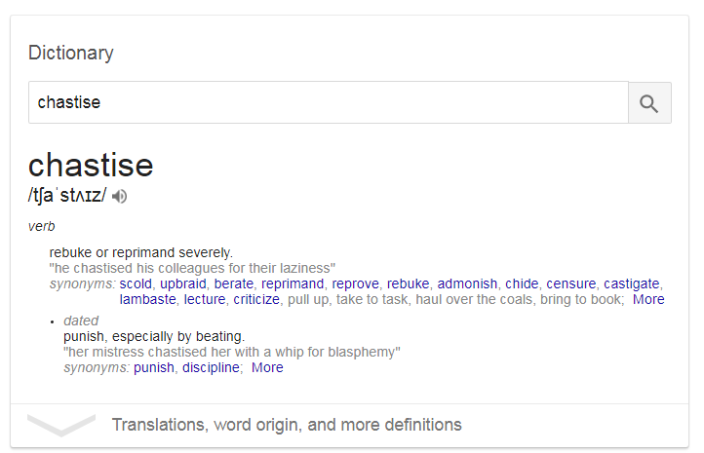
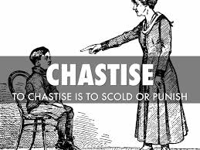

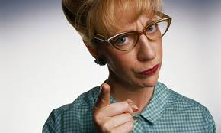
“And chastise with the valour of my tongue”

Slide 6
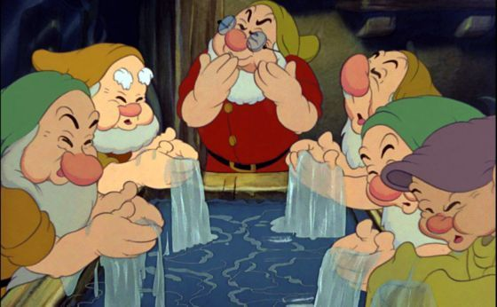
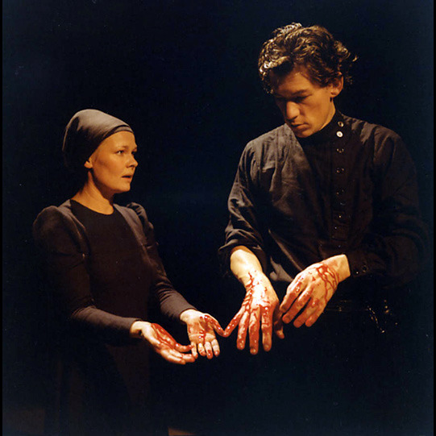
after killing the king, she tries to get him to wash this “filthy witness from your hands”

Slide 7
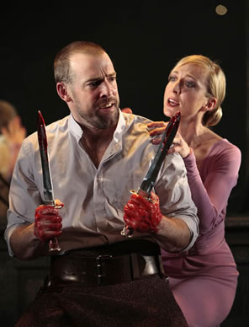
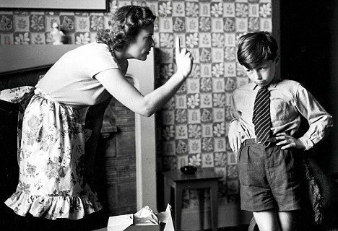
“Why did you bring these daggers from the place?
They must lie there. Go carry them and smear
The sleepy grooms with blood.”

Slide 8



Slide 9
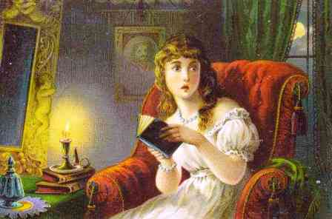
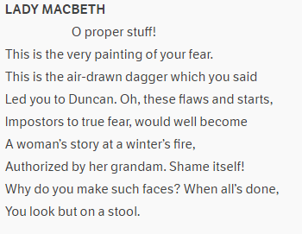
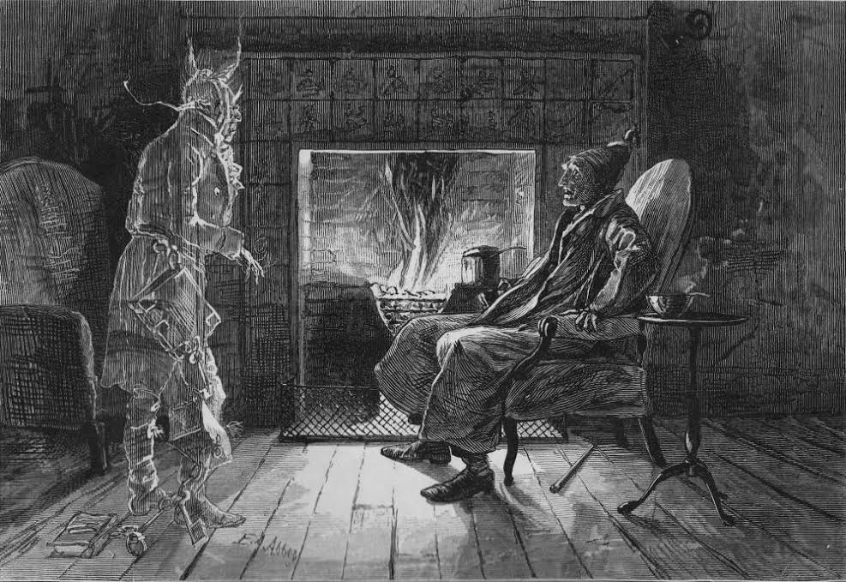
This reminds me of a mother scolding her child after hearing too many tales of some monster under the bed.

Slide 10

Be innocent of the knowledge, dearest chuck,
Till thou applaud the deed.

Slide 11
Given this reading of the play, let’s reconsider the line – from A1 S7 – that finally tips the scales and pushes Macbeth into killing the king…

Slide 12
I have given suck, and know
How tender ’tis to love the babe that milks me.
I would, while it was smiling in my face,
Have plucked my nipple from his boneless gums
And dashed the brains out, had I so sworn as you
Have done to this.
Who is the real babe?
Who is she really threatening here?

Slide 13
How does Shakespeare present the relationship between Macbeth and Lady Macbeth?
LADY MACBETH
Was the hope drunk
Wherein you dress'd yourself? hath it slept since?
And wakes it now, to look so green and pale
At what it did so freely? From this time
Such I account thy love. Art thou afeard
To be the same in thine own act and valour
As thou art in desire? Wouldst thou have that
Which thou esteem'st the ornament of life,
And live a coward in thine own esteem,
Letting 'I dare not' wait upon 'I would,'
Like the poor cat i' the adage?
MACBETH
Prithee, peace:
I dare do all that may become a man;
Who dares do more is none.

Slide 14
While we’re looking at Macbeth as a henpecked husband though, it’s worth looking at the last thing she says before he changes his mind: the whole baby killing business. Obviously, this has led to all the discussion over whether or not they had children before, though I see something different:
In A1 S5 Lady Macbeth says that she wanted to “chastise” Macbeth – the actions of a parent; after killing the king, she tries to get him to wash his hands; she tells him off for bringing the daggers with him; she tells him that it’s “the eye of childhood that fears the painted devil.” After he sees the ghost she compares it to the “air drawn dagger” he saw, in a way that reminds me of a mother scolding her child after hearing too many tales of some monster under the bed. And in my favourite moment, Macbeth tells her, after he’s planned to kill Banquo, that she should know nothing of it until she “applaud the deed.” I imagine some strange toddler version Macbeth sitting on the potty while his beaming mother claps and smiles at his ability to do just what she’s taught him; becauase, after all, here – when he kills Banquo – he is really only doing exactly what she taught him. He is hers now; owned, signed, sealed, delivered.
Based on the above interpretation of their relationship being oedipal, it’s reasonable to suggest that the reason Macbeth was so disturbed by the image of his wife smashing their child’s head against a wall had nothing to do with any theoretic child, but everything to do with the idea that Macbeth was the child. Lady Macbeth killing their child was a veiled threat of violence against Macbeth himself.

